Slide 1
WEB SCRAPING AND WORD FREQUENCY
PYTHON LATEST NEWS
BY- ANKIT KASHYAP

Slide 2
Essential parts of web scraping
Get the website - using HTTP library
Parse the HTML document – using parsing library
Store the library – In text file
We did more focus on parser

Slide 3

Used library in project
Requests
BeautyfulSoup(bs4)
string

Slide 4



Used library in project
Installation
Get data from python.org
HTML Parsing

Slide 5

Used library in project
Extract and save elements

Slide 6
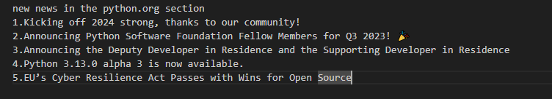
Saved to text file
Saving scrap data to text file

Slide 7
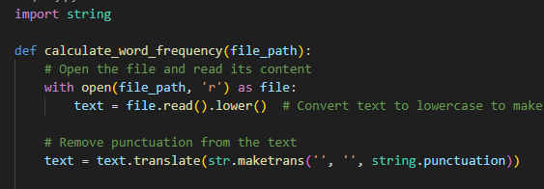
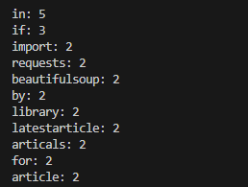
Word frequency analysis
Created text file
Frequency the each words

Slide 8
Result and conclusion
Certainly! In conclusion, the provided Python script serves as a web scraper that extracts the titles of the latest Python articles from the Python.org website. It uses the requests library to fetch the HTML content and BeautifulSoup for parsing. The script then prints the retrieved articles along with index values.

Slide 9
Result and conclusion
In conclusion, the provided Python script efficiently calculates and displays the word frequency and count of a text file. It takes user input for the file path, processes the text content by converting to lowercase, removing punctuation, and then counts and sorts the word frequencies.

Slide 10
Thank you

